Slide 1
Comparing IoT Architectures
In the past several years, architectural standards and frameworks have emerged to address the challenge of designing massive-scale IoT networks.
The foundational concept in all these architectures is supporting data, process, and the functions that endpoint devices perform.
Two of the best-known architectures
oneM2M
IoT World Forum (IoTWF)

Slide 2
The oneM2M IoT Standardized Architecture
European Telecommunications Standards Institute (ETSI) created the M2M Technical Committee in 2008.
The goal of this committee was
To create a common architecture that would help accelerate the adoption of M2M applications and devices.
Over the time, the scope expanded to include IoT

Slide 3
In 2012, ETSI+13 launched oneM2M as a global initiative designed to promote efficient M2M communication systems and IoT.
The goal of oneM2M is to create a common services layer, which can be readily embedded in field devices to allow communication with application servers.
OneM2M framework focuses on IoT Services, applications and Platforms.

Slide 4
One of the greatest challenges in designing an IoT architecture is dealing with the heterogeneity of devices, software, and access methods.
By developing a horizontal platform architecture, oneM2M is developing standards that allow interoperability at all levels of the IoT stack.
E.g Automation of HVAC system with wireless temp sensors.
oneM2M’s horizontal framework and RESTful APIs allow the LoRaWAN(type of LPWAN-Long Range WAN) system to interface with the building management system over an IoT network, thus promoting end-to-end IoT communications in a consistent way, no matter how heterogeneous the networks are.

Slide 5
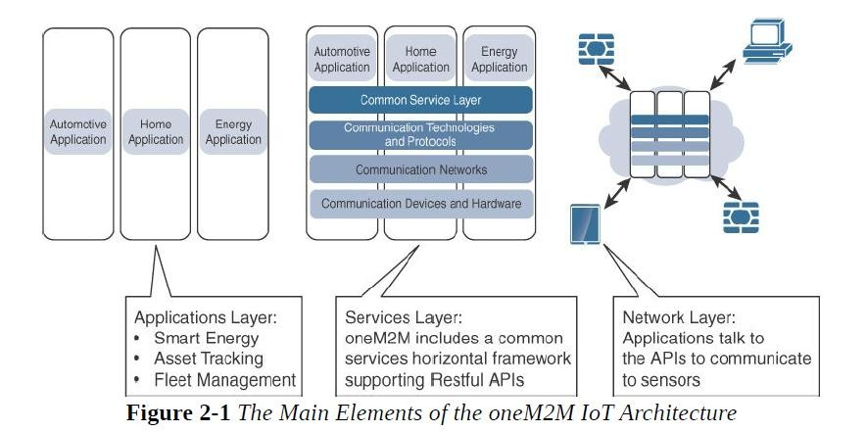
OneM2M promotes interoperability through APIs and supports a wide range of IoT technologies.

Slide 6
The oneM2M architecture divides IoT functions into three major domains: the application layer, the services layer, and the network layer.

Slide 7
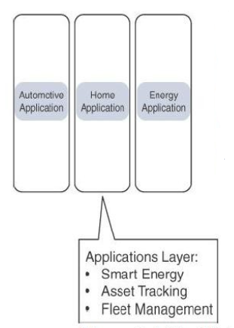
i. oneM2M:Applications layer
The oneM2M architecture gives major attention to connectivity between devices and their applications.
This domain includes the application-layer protocols and attempts to standardize API definitions for interaction with business intelligence (BI) systems.
Applications tend to be industry-specific and have their own sets of data models, and thus they are shown as vertical entities.

Slide 8
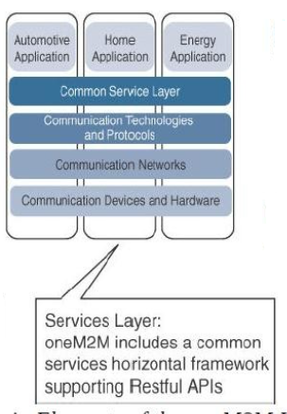
ii. oneM2M : Services layer
This layer is shown as a horizontal framework across the vertical industry applications.
At this layer, horizontal modules include the physical network that the IoT applications run on, the underlying management protocols, and the hardware.
On the top is a common services layer. This conceptual layer adds APIs and middleware supporting third party services and applications.

Slide 9
One of the stated goals of oneM2M is “To develop technical specifications which address the need for a common M2M Service Layer that can be readily embedded within various hardware and software nodes, and rely upon connecting the myriad of devices in the field area network to M2M application servers, which typically reside in a cloud or data center.”
A critical objective of oneM2M is to attract and actively involve organizations from M2M-related business domains, including telematics and intelligent transportation, healthcare, utility, industrial automation, and smart home applications

Slide 10
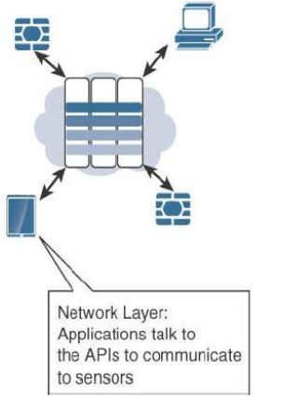
iii. oneM2M : Network Layer
This is the communication domain for the IoT devices and endpoints.
It includes the devices themselves and the communication network that links them.
The communications infrastructure include wireless mesh technologies, such as IEEE 802.15.4, and wireless point-to-multipoint systems, such as IEEE 801.11
Also included are wired device connections, such as IEEE 1901 power line communications.

Slide 11
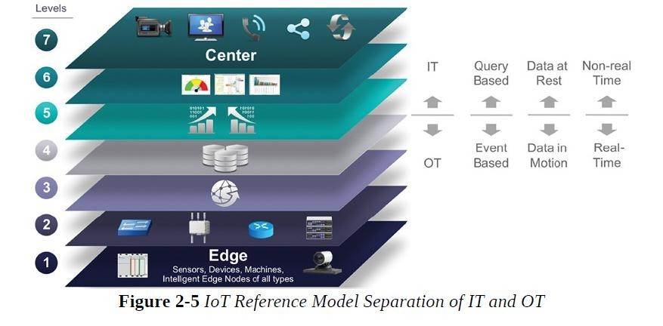
IT and OT Responsibilities in the IoT Reference Model

Slide 12
The bottom of the stack is generally in the domain of OT.
For an industry like oil and gas, this includes sensors and devices connected to pipelines, oil rigs, refinery machinery, and so on.
The top of the stack is in the IT area and includes things like the servers, databases, and applications, all of which run on a part of the network controlled by IT.

Slide 13
At the bottom, in the OT layers, the devices generate real-time data at their own rate
data has to be buffered or stored at certain points within the IoT stack.
Layering data management in this way throughout the stack helps the top four layers handle data at their own speed.

Slide 14
the real-time “data in motion” close to the edge has to be organized and stored so that it becomes “data at rest” for the applications in the IT tiers.
The IT and OT organizations need to work together for overall data management.

Slide 15
Additional IoT Reference Models
Purdue model for control Hierarchy
Industrial Internet Reference Architecture(IIRA) by Industrial Internet Consortium(IIC)
Internet of Things-Architecture(IoT-A)

